Slide 1
Efficient Algorithms
Ekkapot Charoenwanit
Electrical and Computer Engineering (ECE)
TGGS
KMUTNB

Slide 2
Lecture 11: Graph Algorithms (Part III)
All-Pair Shortest Paths (APSP)

Slide 3
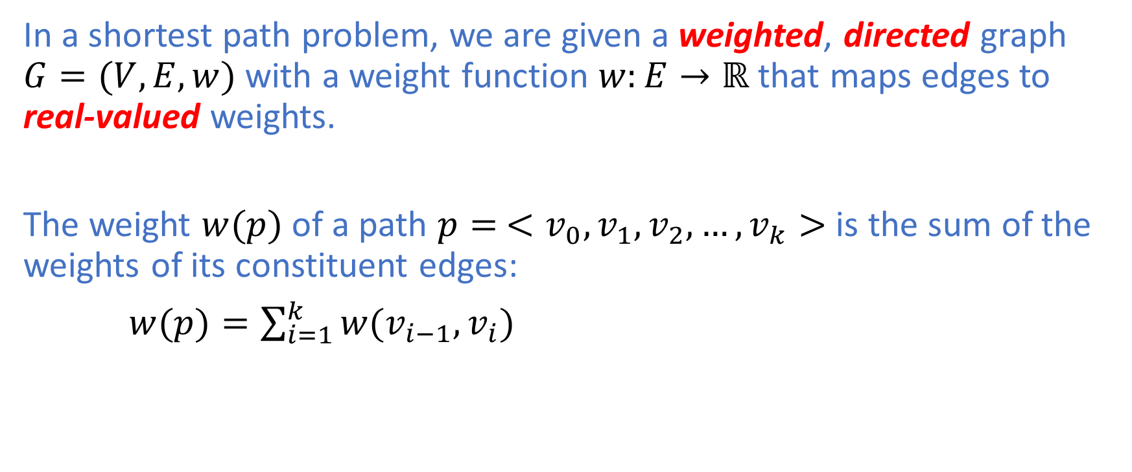
Shortest Path Problem
In a shortest path problem, we are given a weighted, directed graph $G=(V,E,w)$ with a weight function $w:E→ℝ$ that maps edges to real-valued weights.
The weight $w(p)$ of a path $p=$ $<v_{0},v_{1},v_{2},…,v_{k}>$ is the sum of the weights of its constituent edges:
$w(p)=\sum_{i=1}^{k}{w(v_{i−1},v_{i})}$

Slide 4
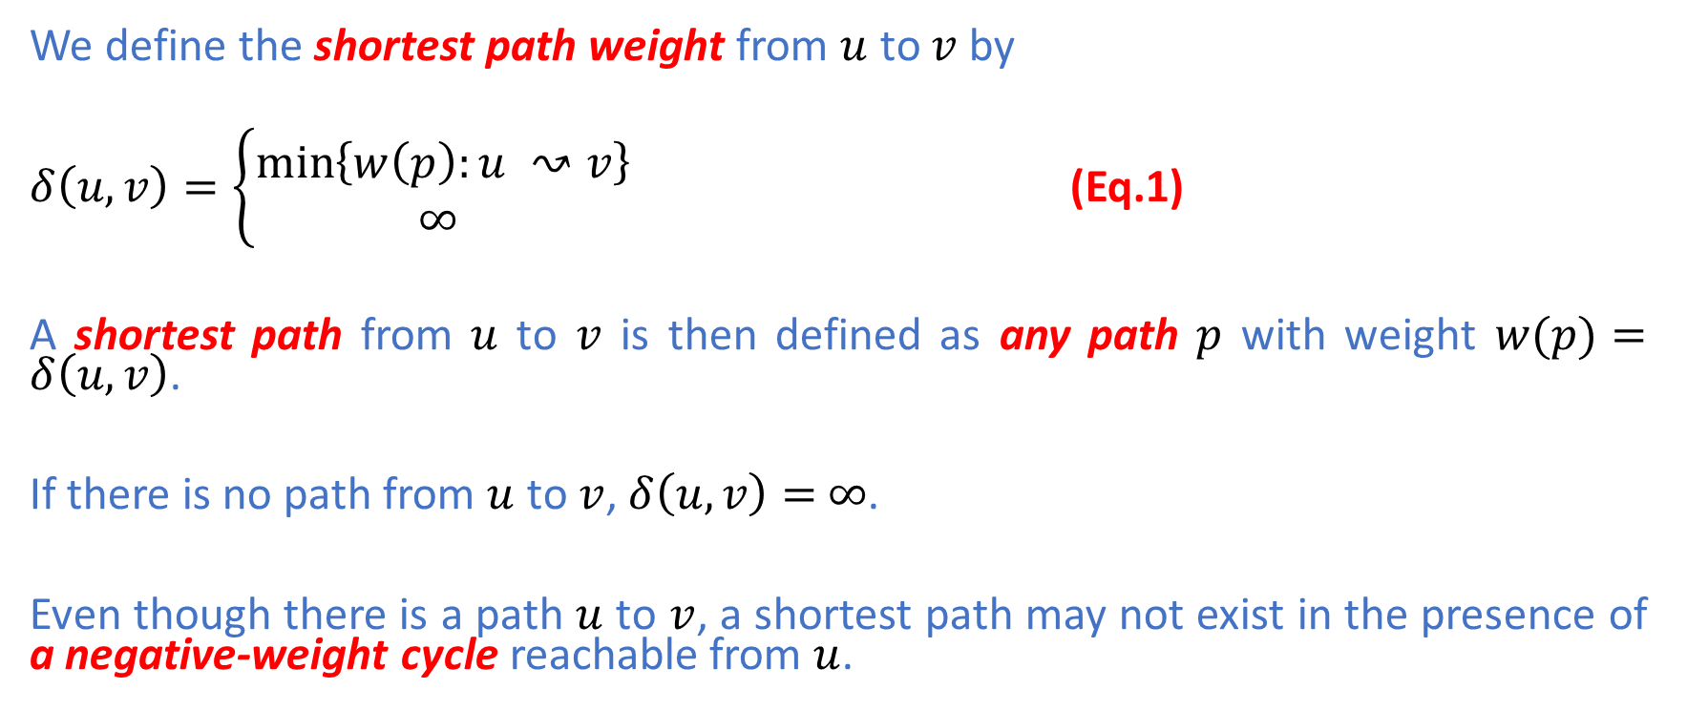
Shortest Path Problem
We define the shortest path weight from $u$ to $v$ by
$δ\left(u,v\right)=\left\{\begin{aligned}\min\left\{w\left(p\right):u ↝v\right\} \\ ∞ \end{aligned}\right.$ (Eq.1)
A shortest path from $u$ to $v$ is then defined as any path $p$ with weight $w(p)=δ\left(u,v\right)$.
If there is no path from $u$ to $v$, $δ\left(u,v\right)=$ $∞$.
Even though there is a path $u$ to $v$, a shortest path may not exist in the presence of a negative-weight cycle reachable from $u$.

Slide 5
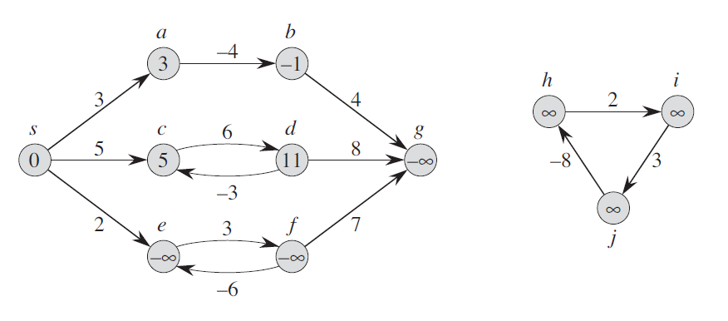
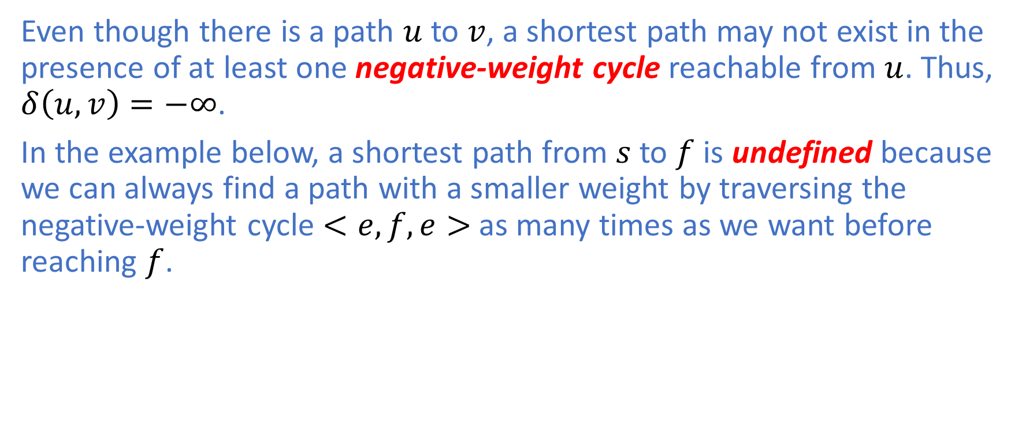
Negative-Weight Cycle
Even though there is a path $u$ to $v$, a shortest path may not exist in the presence of at least one negative-weight cycle reachable from $u$. Thus, $δ\left(u,v\right)=−∞$.
In the example below, a shortest path from $s$ to $f$ is undefined because we can always find a path with a smaller weight by traversing the negative-weight cycle $<e,f,e>$ as many times as we want before reaching $f$.

Slide 6
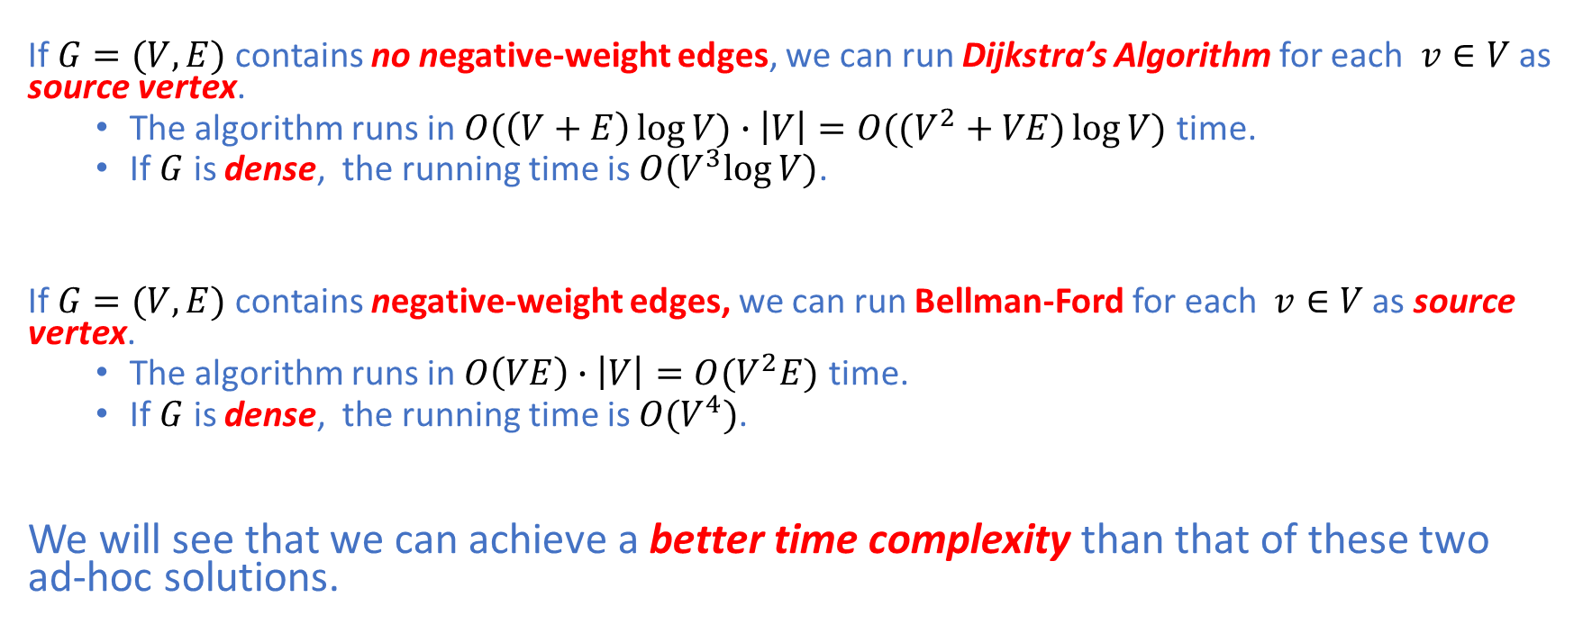
All-Pair Shortest Paths: Ad-hoc Solutions
If $G=(V,E)$ contains no negative-weight edges, we can run Dijkstra’s Algorithm for each $v∈V$ as source vertex.
The algorithm runs in $O(\left(V+E\right)\log{V)∙\left|V\right|=O((V^{2}+VE)\log{V)}}$ time.
If $G$ is dense, the running time is $O(V^{3}log{V)}$.
If $G=(V,E)$ contains negative-weight edges, we can run Bellman-Ford for each $v∈V$ as source vertex.
The algorithm runs in $O\left(VE\right)∙\left|V\right|=O(V^{2}E)$ time.
If $G$ is dense, the running time is $O(V^{4})$.
We will see that we can achieve a better time complexity than that of these two ad-hoc solutions.

Slide 7
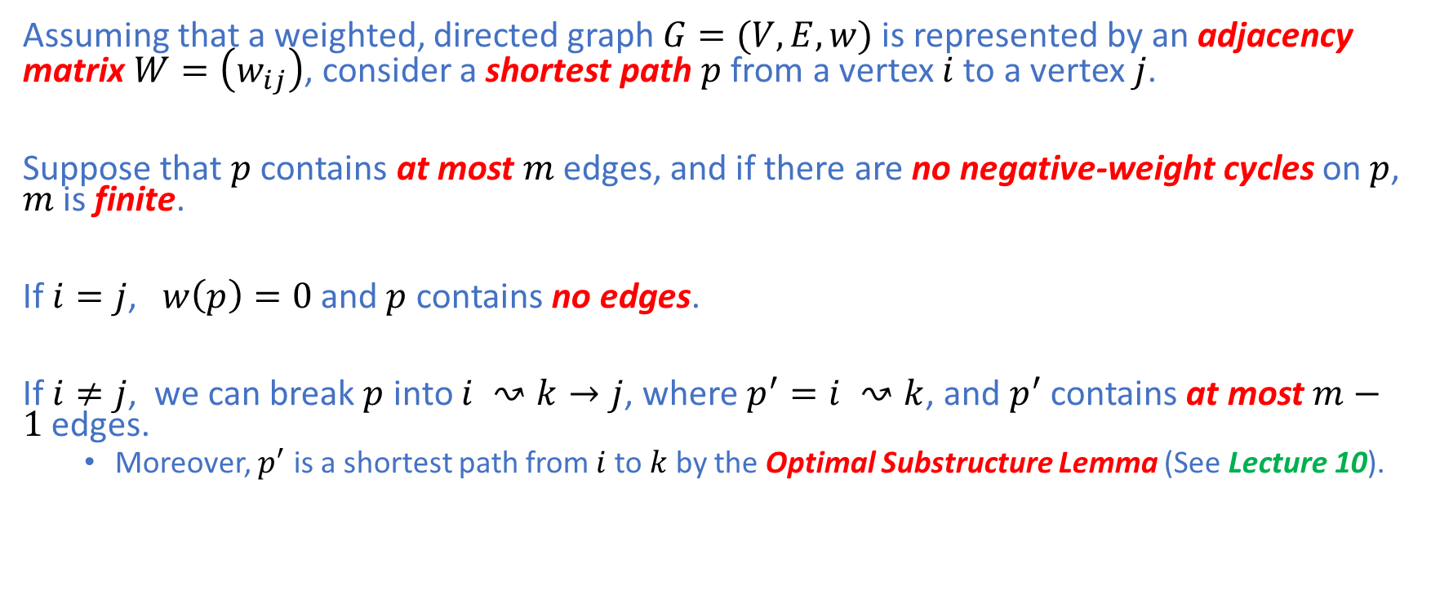
DP Solution
Assuming that a weighted, directed graph $G=(V,E,w)$ is represented by an adjacency matrix $W=\left(w_{ij}\right)$, consider a shortest path $p$ from a vertex $i$ to a vertex $j$.
Suppose that $p$ contains at most $m$ edges, and if there are no negative-weight cycles on $p$, $m$ is finite.
If $i=j$, $w\left(p\right)=0$ and $p$ contains no edges.
If $i≠j$, we can break $p$ into $i ↝k→j$, where $p^{′}=i ↝k$, and $p^{′}$ contains at most $m−1$ edges.
Moreover, $p^{′}$ is a shortest path from $i$ to $k$ by the Optimal Substructure Lemma (See Lecture 10).

Slide 8
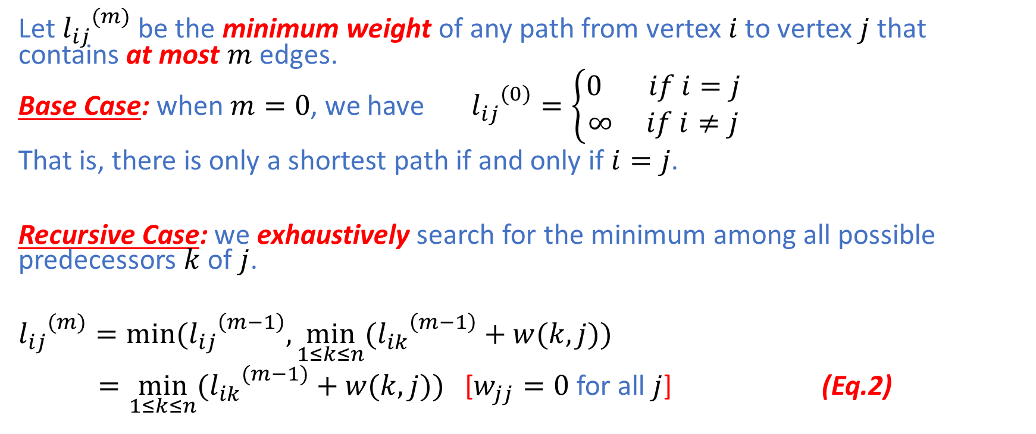
DP Solution: Recurrence Formulation
Let ${l_{ij}}^{(m)}$ be the minimum weight of any path from vertex $i$ to vertex $j$ that contains at most $m$ edges.
Base Case: when $m=0$, we have ${l_{ij}}^{(0)}=\left\{\begin{aligned}0 if i=j \\ ∞ if i≠j\end{aligned}\right.$
That is, there is only a shortest path if and only if $i=j$.
Recursive Case: we exhaustively search for the minimum among all possible predecessors $k$ of $j$.
$${l_{ij}}^{(m)}=min⁡({l_{ij}}^{\left(m−1\right)},\min_{1≤k≤n}{({l_{ik}}^{\left(m−1\right)}+w(k,j)})$$
$=\min_{1≤k≤n}{({l_{ik}}^{(m−1)}+w(k,j))}$ [$w_{jj}=0$ for all $j$] (Eq.2)

Slide 9
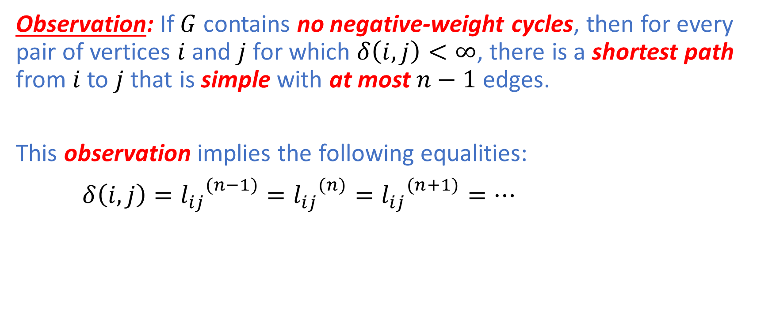
DP Solution
Observation: If $G$ contains no negative-weight cycles, then for every pair of vertices $i$ and $j$ for which $δ\left(i,j\right)<∞$, there is a shortest path from $i$ to $j$ that is simple with at most $n−1$ edges.
This observation implies the following equalities:
$δ\left(i,j\right)={l_{ij}}^{(n−1)}={l_{ij}}^{(n)}={l_{ij}}^{(n+1)}=…$

Slide 10
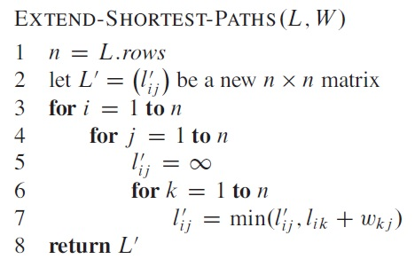
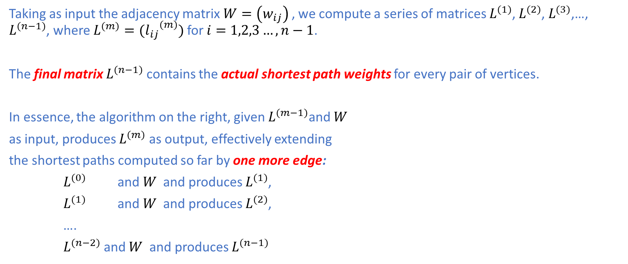
DP Solution: Bottom-Up Solution
Taking as input the adjacency matrix $W=\left(w_{ij}\right)$ , we compute a series of matrices $L^{(1)}$, $L^{(2)}$, $L^{(3)}$,…, $L^{(n−1)}$, where $L^{(m)}=({l_{ij}}^{(m)})$ for $i=1,2,3…,n−1$.
The final matrix $L^{(n−1)}$ contains the actual shortest path weights for every pair of vertices.
In essence, the algorithm on the right, given $L^{(m−1)}$and $W$
as input, produces $L^{(m)}$ as output, effectively extending
the shortest paths computed so far by one more edge:
$L^{(0)}$ and $W$ and produces $L^{(1)}$,
$L^{(1)}$ and $W$ and produces $L^{(2)}$,
….
$L^{(n−2)}$ and $W$ and produces $L^{(n−1)}$

Slide 11

DP Solution: Bottom-Up Solution
Since the algorithm consists of triply nested for loops, each of which executes for exactly $n$ times, the running time is $Θ(n^{3})$.

Slide 12
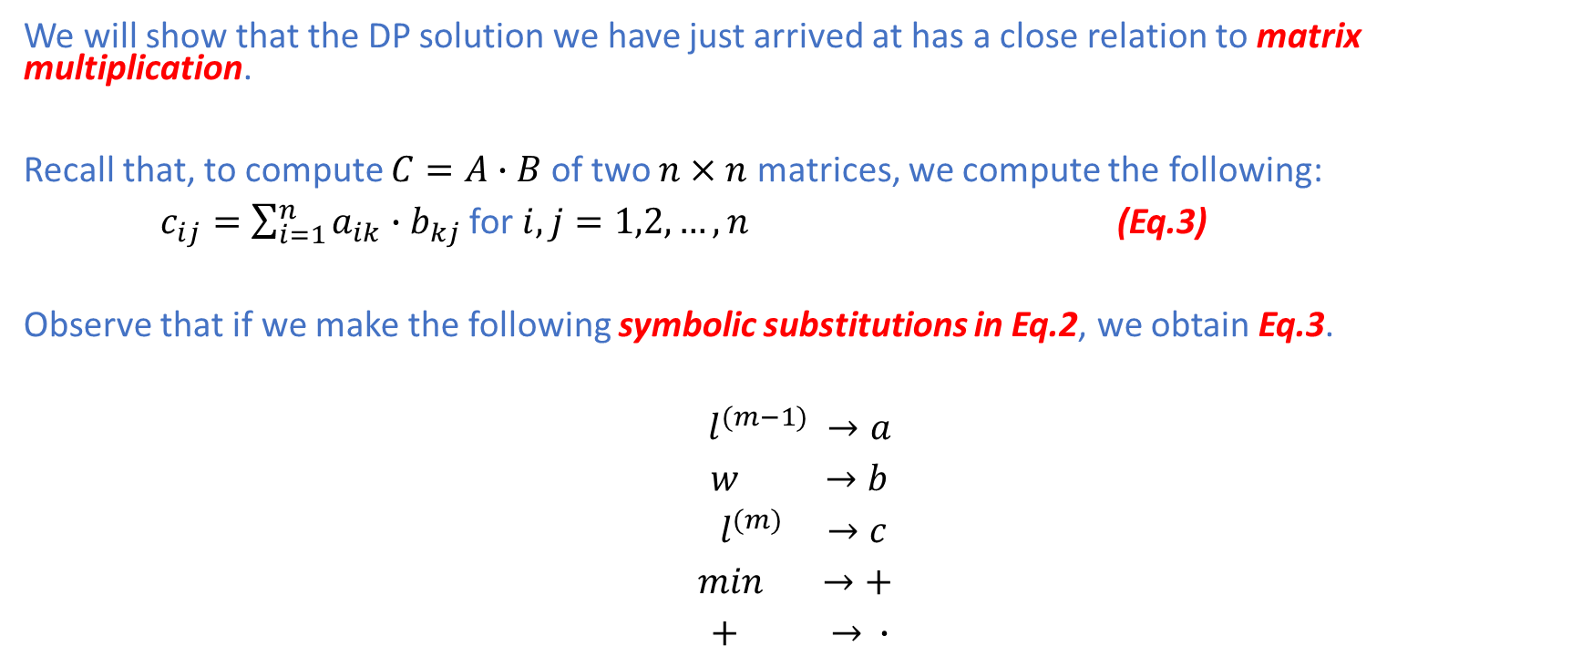
DP Solution: Matrix Multiplication View
We will show that the DP solution we have just arrived at has a close relation to matrix multiplication.
Recall that, to compute $C=A∙B$ of two $n×n$ matrices, we compute the following:
$c_{ij}=\sum_{i=1}^{n}{a_{ik}∙b_{kj}}$ for $i,j=1,2,…,n$ (Eq.3)
Observe that if we make the following symbolic substitutions in Eq.2, we obtain Eq.3.
$l^{(m−1)} →a$
$w →b$
$l^{(m)} →c$
$\min{ }→+$
$+ → ∙$

Slide 13
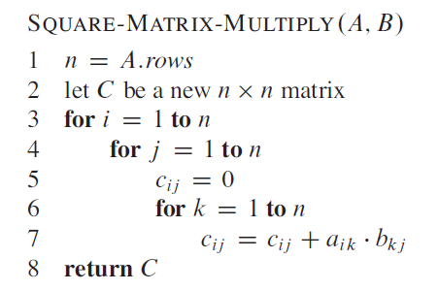

DP Solution: Matrix Multiplication View
Thus, if we apply these changes to $Extend−Shortest−Paths$ and replace $∞$ with $0$, we obtain the following matrix multiplication algorithm we are familiar with. (See Lecture 6)

Slide 14
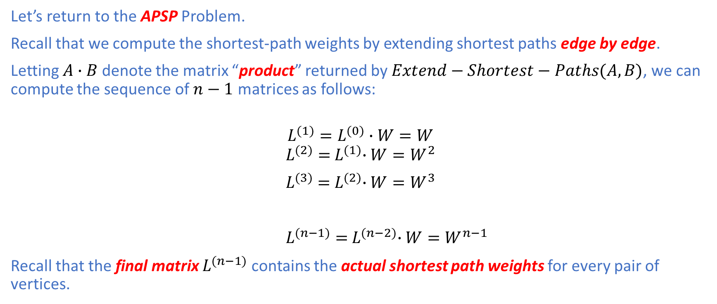
DP Solution: Matrix Multiplication View
Let’s return to the APSP Problem.
Recall that we compute the shortest-path weights by extending shortest paths edge by edge.
Letting $A∙B$ denote the matrix “product” returned by $Extend−Shortest−Paths(A,B)$, we can compute the sequence of $n−1$ matrices as follows:
$$L^{(1)}=L^{(0)}∙W=W$$
$$L^{(2)}={ L}^{(1)}∙W=W^{2}$$
$L^{(3)}={ L}^{(2)}∙W=W^{3}$
$L^{(n−1)}={ L}^{(n−2)}∙W=W^{n−1}$
Recall that the final matrix $L^{(n−1)}$ contains the actual shortest path weights for every pair of vertices.

Slide 15
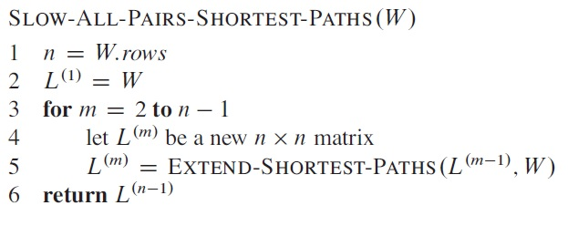

DP Solution: Matrix Multiplication View
We arrive at the following SLOW algorithm to compute all-pair shortest paths.
The algorithm starts by initializing $L^{(1)}=W$ and extends the shortest paths computed so far by one edge at a time.
$L^{(n−1)}$ returned by the algorithm contains the actual shortest paths.
The algorithm runs in $Θ(n^{4})$ time because there are $n−2=Θ(n)$ iterations, each of which runs in $Θ(n^{3})$ time.

Slide 16
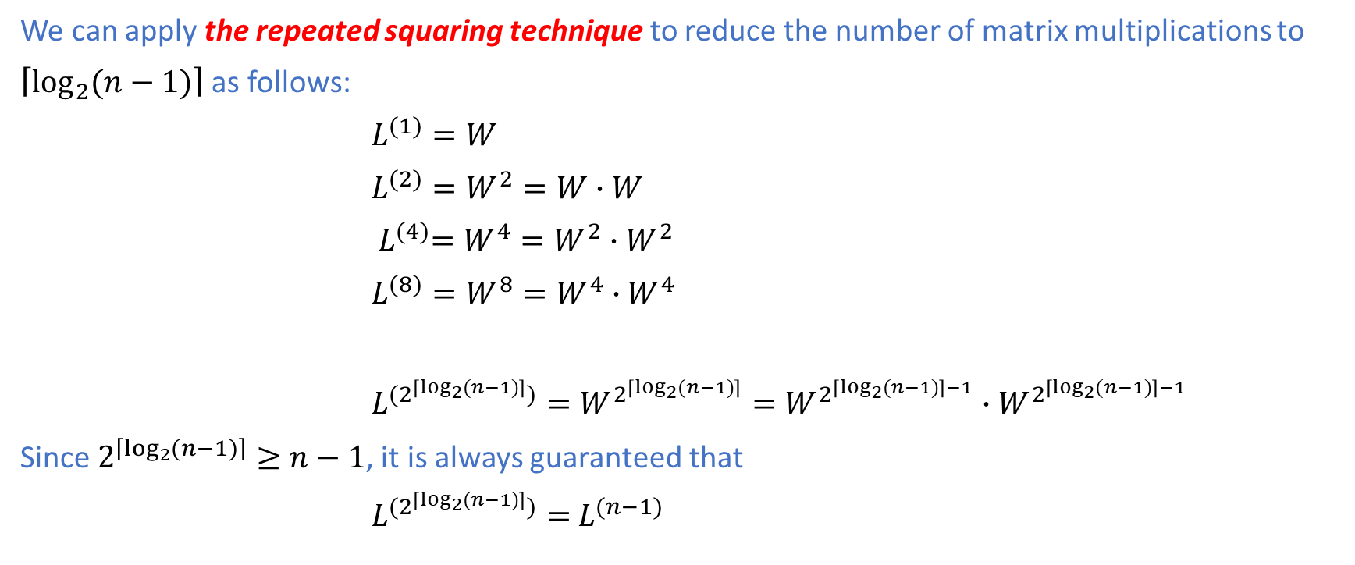
DP Solution: Matrix Multiplication View
We can apply the repeated squaring technique to reduce the number of matrix multiplications to
$\left\lceil \log_{2}{(n−1)}\right\rceil$ as follows:
$L^{(1)}=W$
$L^{(2)}=W^{2}=W∙W$
${ L}^{(4)}=W^{4}=W^{2}∙W^{2}$
$L^{(8)}=W^{8}=W^{4}∙W^{4}$
$L^{(2^{\left\lceil \log_{2}{(n−1)}\right\rceil })}=W^{2^{\left\lceil \log_{2}{(n−1)}\right\rceil }}=W^{2^{\left\lceil \log_{2}{(n−1)}\right\rceil −1}}∙W^{2^{\left\lceil \log_{2}{(n−1)}\right\rceil −1}}$
Since $2^{\left\lceil \log_{2}{(n−1)}\right\rceil }≥n−1$, it is always guaranteed that
$L^{(2^{\left\lceil \log_{2}{(n−1)}\right\rceil })}=$ $L^{(n−1)}$

Slide 17
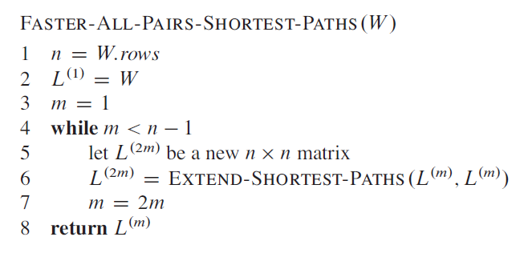

DP Solution: Matrix Multiplication View
The following faster algorithm can achieve a better time complexity of $Θ(n^{3}\log{n})$ using the repeated squaring technique:
There are $\left\lceil \log_{2}{(n−1)}\right\rceil$ matrix multiplications, each of which takes $Θ(n^{3})$ time.

Slide 18
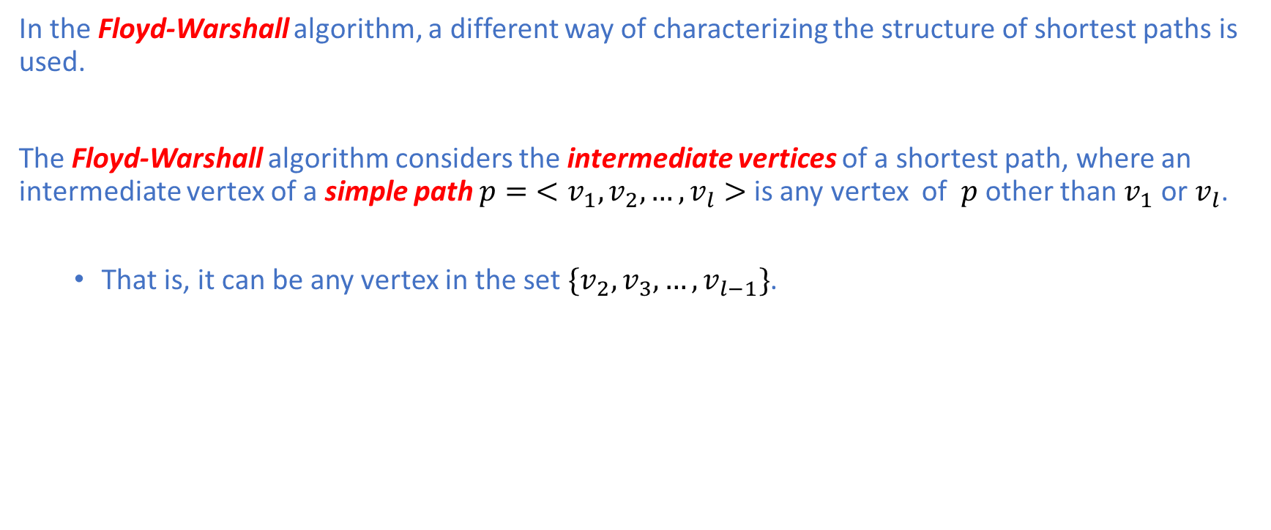
The Floyd-Warshall Algorithm
In the Floyd-Warshall algorithm, a different way of characterizing the structure of shortest paths is used.
The Floyd-Warshall algorithm considers the intermediate vertices of a shortest path, where an intermediate vertex of a simple path $p=$ $<v_{1},v_{2},…,v_{l}>$ is any vertex of $p$ other than $v_{1}$ or $v_{l}$.
That is, it can be any vertex in the set $\{v_{2},v_{3},…,v_{l−1}\}$.

Slide 19
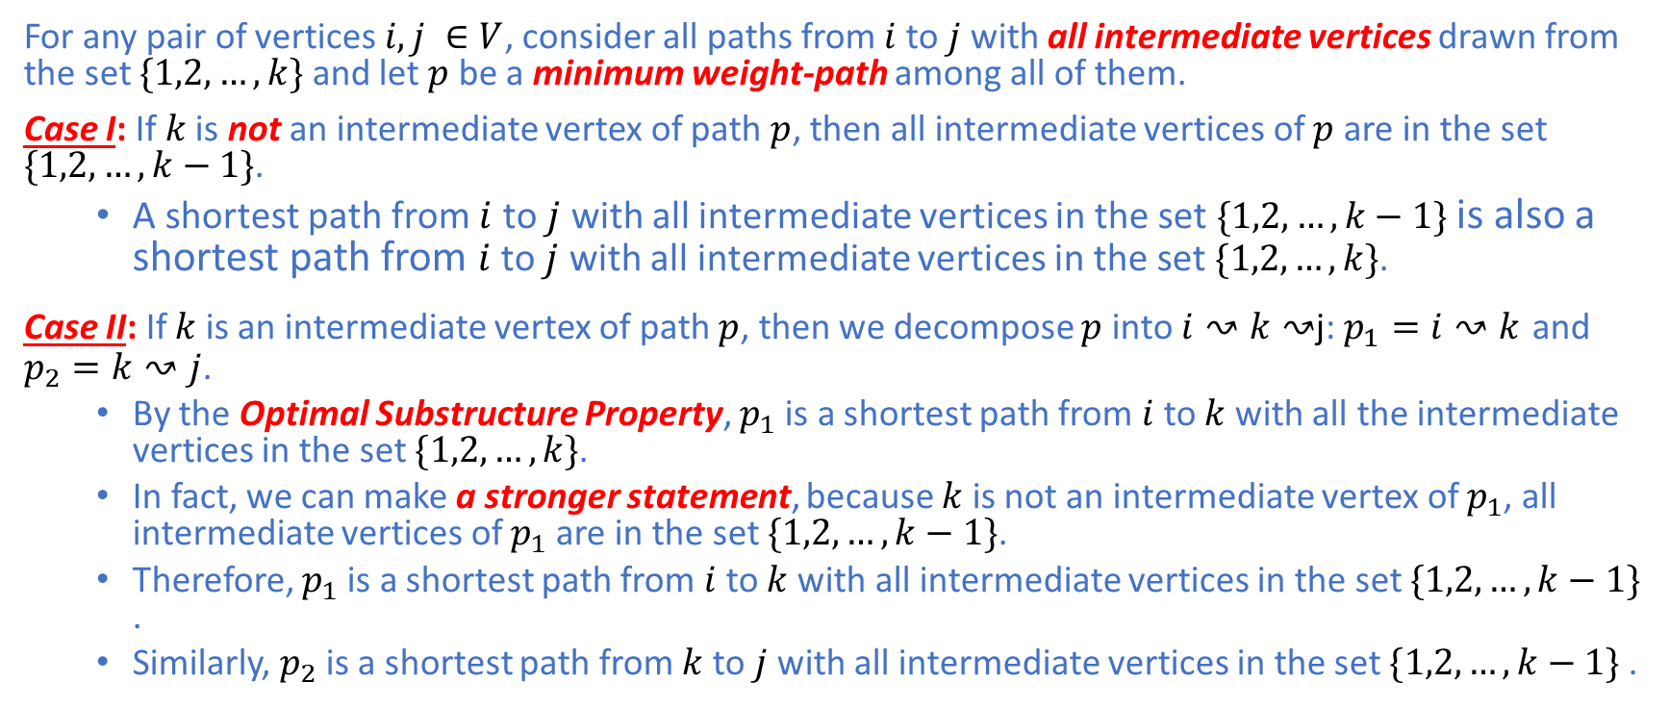
The Floyd-Warshall Algorithm
For any pair of vertices $i,j ∈V$, consider all paths from $i$ to $j$ with all intermediate vertices drawn from the set $\{1,2,…,k\}$ and let $p$ be a minimum weight-path among all of them.
Case I: If $k$ is not an intermediate vertex of path $p$, then all intermediate vertices of $p$ are in the set $\{1,2,…,k−1\}$.
A shortest path from $i$ to $j$ with all intermediate vertices in the set $\{1,2,…,k−1\}$ is also a shortest path from $i$ to $j$ with all intermediate vertices in the set $\{1,2,…,k\}$.
Case II: If $k$ is an intermediate vertex of path $p$, then we decompose $p$ into $i↝k↝$j: $p_{1}=i↝k$ and $p_{2}=k↝j$.
By the Optimal Substructure Property, $p_{1}$ is a shortest path from $i$ to $k$ with all the intermediate vertices in the set $\{1,2,…,k\}$.
In fact, we can make a stronger statement, because $k$ is not an intermediate vertex of $p_{1}$, all intermediate vertices of $p_{1}$ are in the set $\{1,2,…,k−1\}$.
Therefore, $p_{1}$ is a shortest path from $i$ to $k$ with all intermediate vertices in the set $\{1,2,…,k−1\}$ .
Similarly, $p_{2}$ is a shortest path from $k$ to $j$ with all intermediate vertices in the set $\{1,2,…,k−1\}$ .

Slide 20
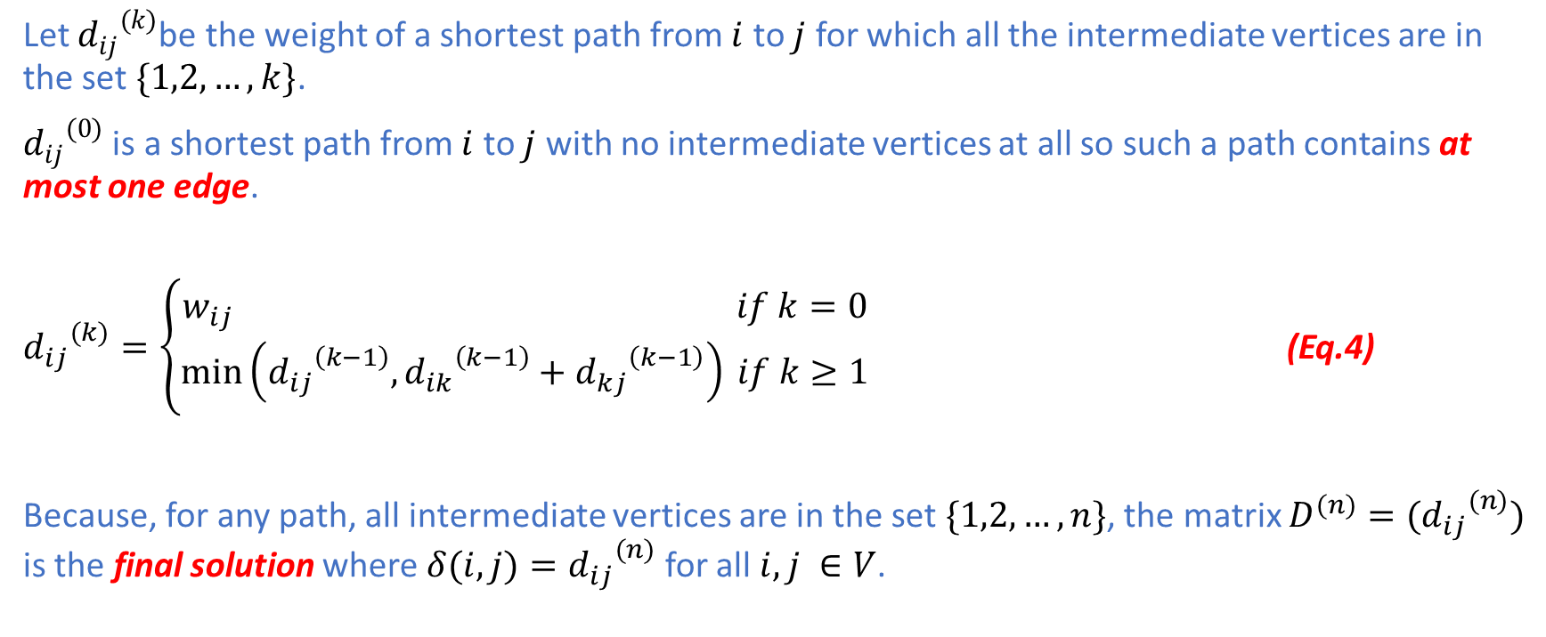
The Floyd-Warshall Algorithm
Let ${d_{ij}}^{(k)}$be the weight of a shortest path from $i$ to $j$ for which all the intermediate vertices are in the set $\{1,2,…,k\}$.
${d_{ij}}^{(0)}$ is a shortest path from $i$ to $j$ with no intermediate vertices at all so such a path contains at most one edge.
${d_{ij}}^{(k)}=\left\{\begin{aligned}w_{ij} if k=0 \\ \min\left({d_{ij}}^{\left(k−1\right)},{d_{ik}}^{\left(k−1\right)}+{d_{kj}}^{\left(k−1\right)}\right) if k≥1\end{aligned}\right.$ (Eq.4)
Because, for any path, all intermediate vertices are in the set $\{1,2,…,n\}$, the matrix $D^{(n)}=({d_{ij}}^{(n)})$ is the final solution where ${{δ(i,j)=d}_{ij}}^{(n)}$ for all $i,j ∈V$.

Slide 21
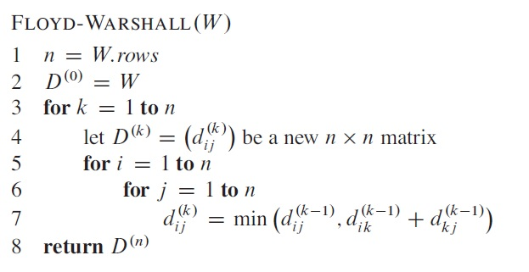

The Floyd-Warshall Algorithm
The Floyd-Warshall Algorithm consists of three nested for loops, each of which executes exactly $n$ iterations.
Because each execution of line 7 takes $Θ(1)$ time, the total running time is$n^{3}∙Θ\left(1\right)=Θ(n^{3})$.

Slide 22
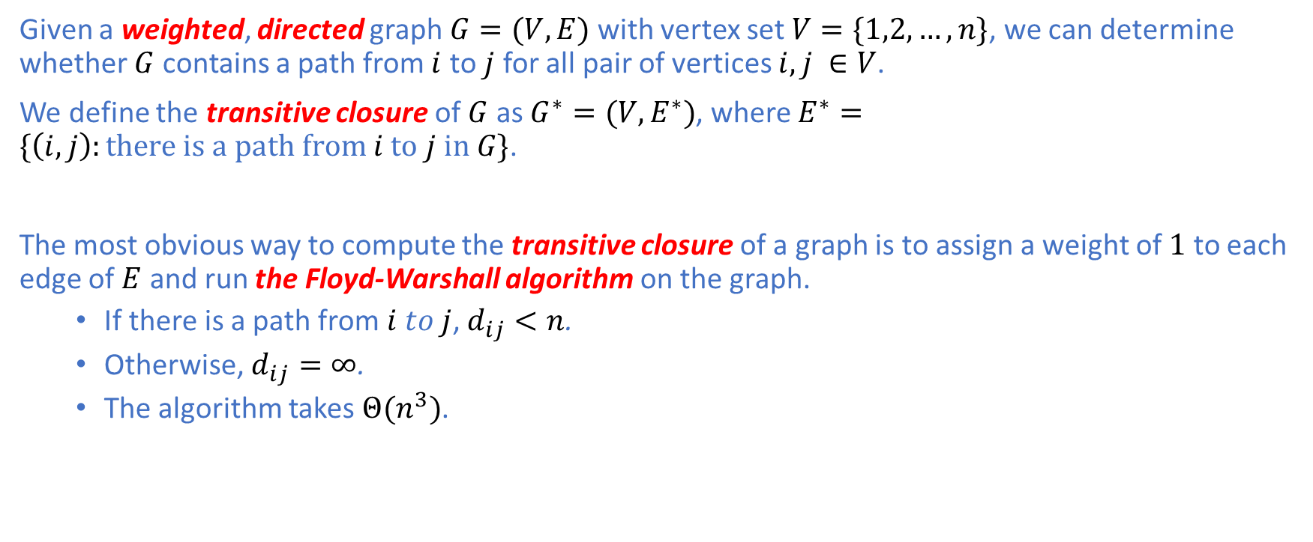
Transitive Closure of a Directed Graph
Given a weighted, directed graph $G=(V,E)$ with vertex set $V=\{1,2,…,n\}$, we can determine whether $G$ contains a path from $i$ to $j$ for all pair of vertices $i,j ∈V$.
We define the transitive closure of $G$ as $G^{∗}=(V,E^{∗})$, where $E^{∗}=\{\left(i,j\right):there is a path from i to j in G\}$.
The most obvious way to compute the transitive closure of a graph is to assign a weight of $1$ to each edge of $E$ and run the Floyd-Warshall algorithm on the graph.
If there is a path from $i to j$, $d_{ij}<n$.
Otherwise, $d_{ij}=∞$.
The algorithm takes $Θ(n^{3})$.

Slide 23
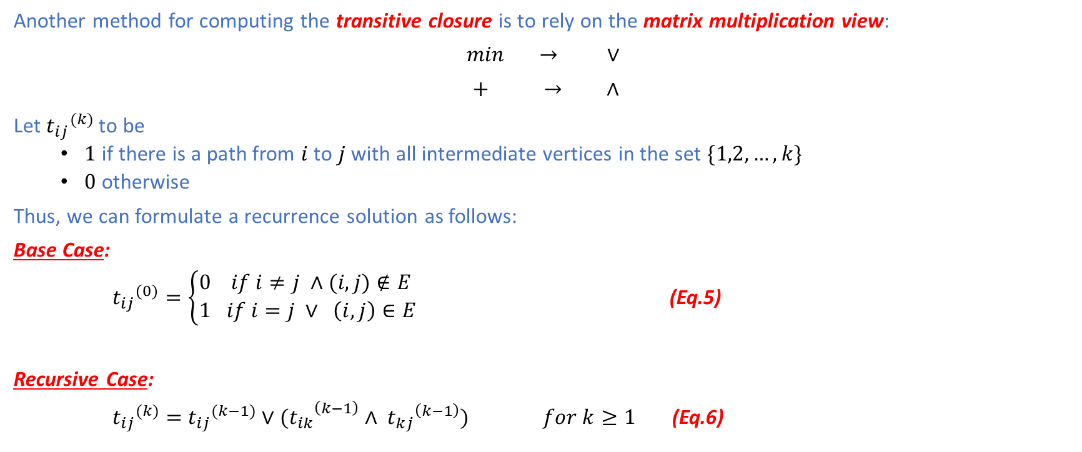
Transitive Closure of a Directed Graph
Another method for computing the transitive closure is to rely on the matrix multiplication view:
$\min{ }→ ∨$
$+ → ∧$
Let ${t_{ij}}^{(k)}$ to be
$1$ if there is a path from $i$ to $j$ with all intermediate vertices in the set $\{1,2,…,k\}$
$0$ otherwise
Thus, we can formulate a recurrence solution as follows:
Base Case:
${t_{ij}}^{(0)}=\left\{\begin{aligned}0 if i≠j ∧(i,j)∉E \\ 1 if i=j ∨ \left(i,j\right)∈E\end{aligned}\right.$ (Eq.5)
Recursive Case:
${t_{ij}}^{(k)}=$ ${t_{ij}}^{(k−1)}∨{{(t}_{ik}}^{\left(k−1\right)} ∧ {t_{kj}}^{\left(k−1\right)}) for k≥1$ (Eq.6)

Slide 24
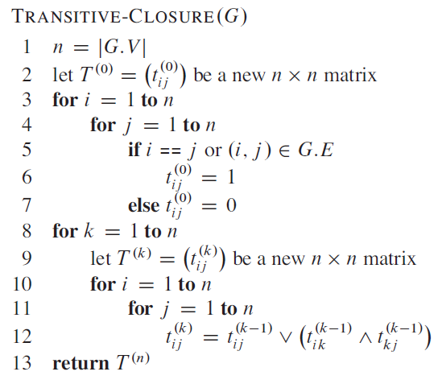

Transitive Closure of a Directed Graph
As in the Floyd-Warshall algorithm, we compute the sequence of matrices $T^{(k)}=({t_{ij}}^{(k)})$ for $k=1,2,…n−1$.
The algorithm takes $Θ(n^{3})$ time.
There are three nested for loops, each of which executes exactly $n$ iterations.
Therefore, there are $n^{3}$ iterations in total.
Each iteration takes $Θ(1)$ time (line 12)

Slide 25
Johnson’s Algorithm
Johnson’s Algorithm computes all-pair shortest paths for all the vertices.
Suitable for sparse graphs
Asymptotically better than the Floyd-Warshall algorithm
Either returns a matrix of shortest paths for all pairs of vertices or reports that the graph contains a negative-weight cycle
Uses both Dijkstra’s algorithm and the Bellman-Ford algorithm as subroutines
Uses the reweighting technique

Slide 26
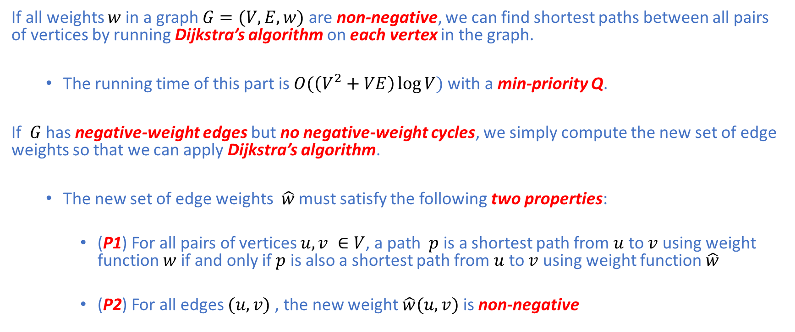
Johnson’s Algorithm: Reweighting
If all weights $w$ in a graph $G=(V,E,w)$ are non-negative, we can find shortest paths between all pairs of vertices by running Dijkstra’s algorithm on each vertex in the graph.
The running time of this part is $O(\left(V^{2}+VE\right)\log{V})$ with a min-priority Q.
If $G$ has negative-weight edges but no negative-weight cycles, we simply compute the new set of edge weights so that we can apply Dijkstra’s algorithm.
The new set of edge weights $\hat{w}$ must satisfy the following two properties:
(P1) For all pairs of vertices $u,v ∈V$, a path $p$ is a shortest path from $u$ to $v$ using weight function $w$ if and only if $p$ is also a shortest path from $u$ to $v$ using weight function $\hat{w}$
(P2) For all edges $(u,v)$, the new weight $\hat{w}(u,v)$ is non-negative

Slide 27
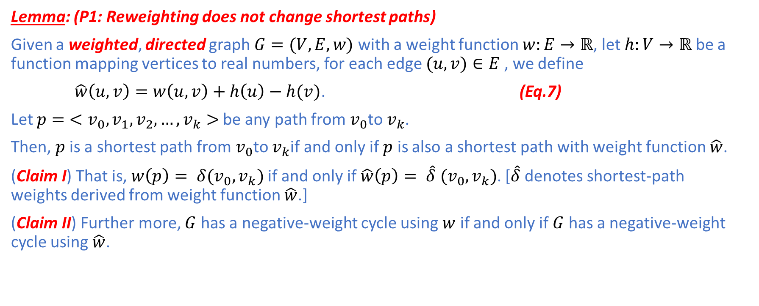
Johnson’s Algorithm: Reweighting
Lemma: (P1: Reweighting does not change shortest paths)
Given a weighted, directed graph $G=(V,E,w)$ with a weight function $w:E→ℝ$, let $h:V→ℝ$ be a function mapping vertices to real numbers, for each edge $(u,v)∈E$, we define
$\hat{w}\left(u,v\right)=w\left(u,v\right)+h\left(u\right)−h(v)$. (Eq.7)
Let $p=$ $<v_{0},v_{1},v_{2},…,v_{k}>$ be any path from $v_{0}$to $v_{k}$.
Then, $p$ is a shortest path from $v_{0}$to $v_{k}$if and only if $p$ is also a shortest path with weight function $\hat{w}$.
(Claim I) That is, $w\left(p\right)= δ(v_{0},v_{k})$ if and only if $\hat{w}\left(p\right)= \hat{δ} (v_{0},v_{k})$. [$\hat{δ}$denotes shortest-path weights derived from weight function $\hat{w}$.]
(Claim II) Further more, $G$ has a negative-weight cycle using $w$ if and only if $G$ has a negative-weight cycle using $\hat{w}$.

Slide 28
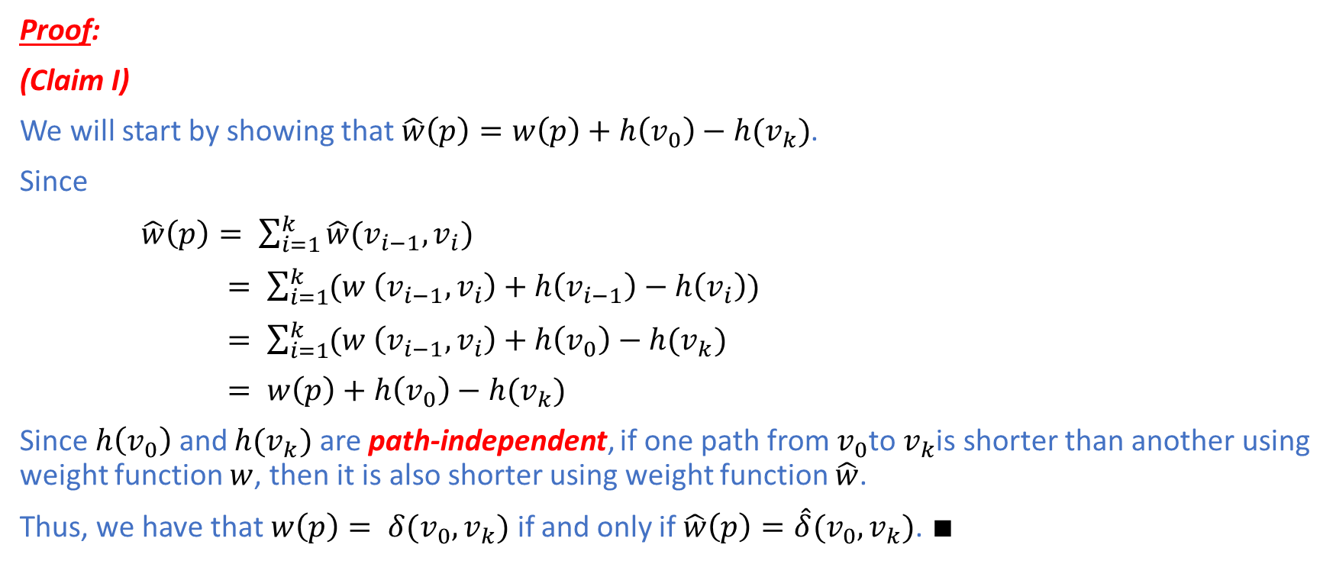
Johnson’s Algorithm: Reweighting
Proof:
(Claim I)
We will start by showing that $\hat{w}\left(p\right)=w\left(p\right)+h\left(v_{0}\right)−h(v_{k})$.
Since
$\hat{w}\left(p\right)= \sum_{i=1}^{k}{\hat{w}(v_{i−1},v_{i})}$
$= \sum_{i=1}^{k}{(w \left(v_{i−1},v_{i}\right)+h\left(v_{i−1}\right)−h\left(v_{i}\right))}$
$= \sum_{i=1}^{k}{(w \left(v_{i−1},v_{i}\right)+h\left(v_{0}\right)−h(v_{k})}$
$= w\left(p\right)+h\left(v_{0}\right)−h(v_{k})$
Since $h\left(v_{0}\right)$ and $h(v_{k})$ are path-independent, if one path from $v_{0}$to $v_{k}$is shorter than another using weight function $w$, then it is also shorter using weight function $\hat{w}$.
Thus, we have that $w\left(p\right)= δ(v_{0},v_{k})$ if and only if $\hat{w}\left(p\right)=\hat{δ}(v_{0},v_{k})$. $∎$

Slide 29
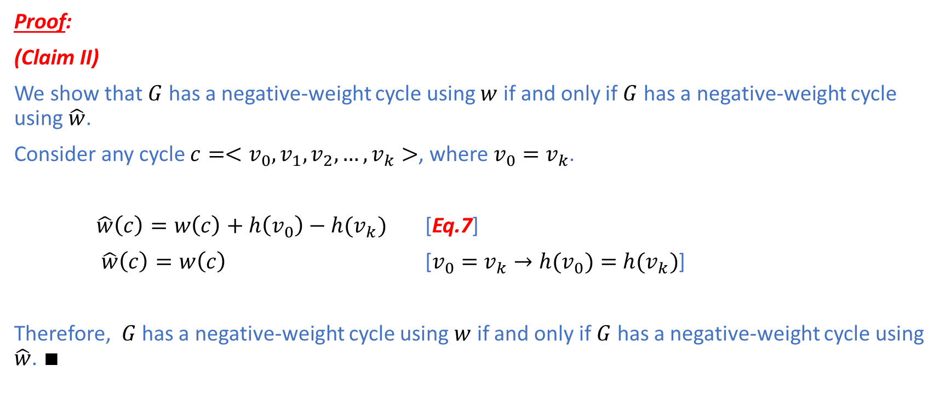
Johnson’s Algorithm: Reweighting
Proof:
(Claim II)
We show that $G$ has a negative-weight cycle using $w$ if and only if $G$ has a negative-weight cycle using $\hat{w}$.
Consider any cycle $c=<v_{0},v_{1},v_{2},…,v_{k}>$, where $v_{0}=$ $v_{k}$.
$\hat{w}\left(c\right)=w\left(c\right)+h\left(v_{0}\right)−h(v_{k})$ [Eq.7]
$\hat{w}\left(c\right)=w\left(c\right)$ [$v_{0}=$ $v_{k}→{h(v}_{0})=$ $h(v_{k})$]
Therefore, $G$ has a negative-weight cycle using $w$ if and only if $G$ has a negative-weight cycle using $\hat{w}$. $∎$

Slide 30
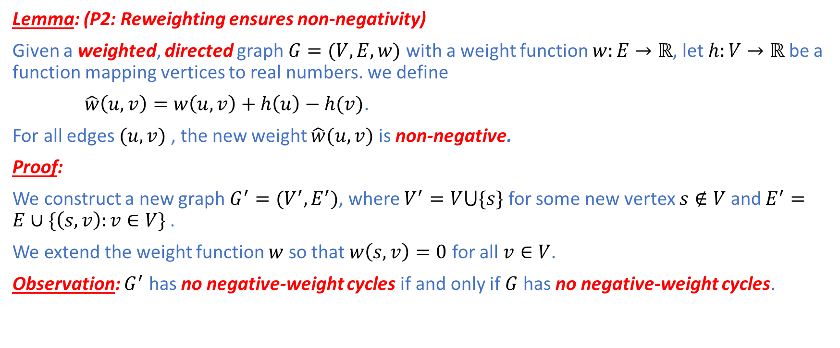
Johnson’s Algorithm: Reweighting
Lemma: (P2: Reweighting ensures non-negativity)
Given a weighted, directed graph $G=(V,E,w)$ with a weight function $w:E→ℝ$, let $h:V→ℝ$ be a function mapping vertices to real numbers. we define
$\hat{w}\left(u,v\right)=w\left(u,v\right)+h\left(u\right)−h(v)$.
For all edges $(u,v)$, the new weight $\hat{w}(u,v)$ is non-negative.
Proof:
We construct a new graph $G^{′}=(V^{′},E^{′})$, where $V^{′}=V⋃\{s\}$ for some new vertex $s∉V$ and $E^{′}=E∪\{\left(s,v\right):v∈V\}$ .
We extend the weight function $w$ so that $w\left(s,v\right)=0$ for all $v∈V$.
Observation: $G^{′}$ has no negative-weight cycles if and only if $G$ has no negative-weight cycles.

Slide 31
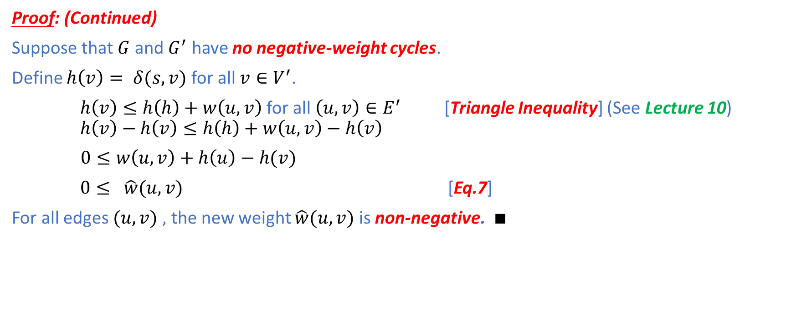
Johnson’s Algorithm: Reweighting
Proof: (Continued)
Suppose that $G$ and $G^{′}$ have no negative-weight cycles.
Define $h\left(v\right)= δ(s,v)$ for all $v∈V^{′}$.
$h\left(v\right)≤h\left(h\right)+w\left(u,v\right)$ for all $\left(u,v\right)∈E^{′}$ [Triangle Inequality] (See Lecture 10) $h\left(v\right)−h\left(v\right)≤h\left(h\right)+w\left(u,v\right)−h\left(v\right)$
$0≤w\left(u,v\right)+h\left(u\right)−h(v)$
$0≤ \hat{w}(u,v)$ [Eq.7]
For all edges $(u,v)$, the new weight $\hat{w}(u,v)$ is non-negative. $∎$

Slide 32
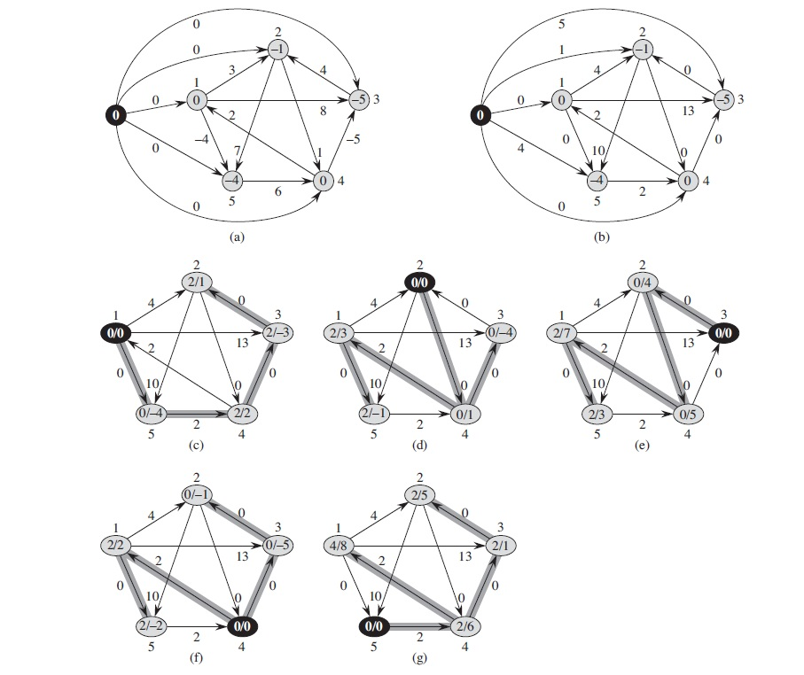
Johnson’s Algorithm: Example

Slide 33
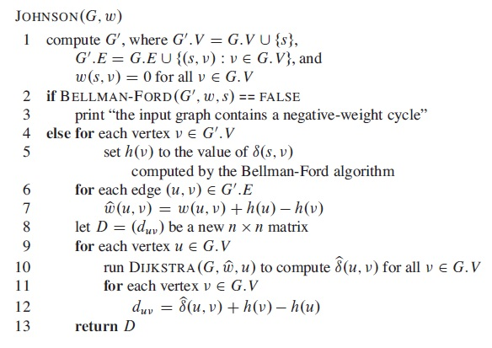
Johnson’s Algorithm

Slide 34
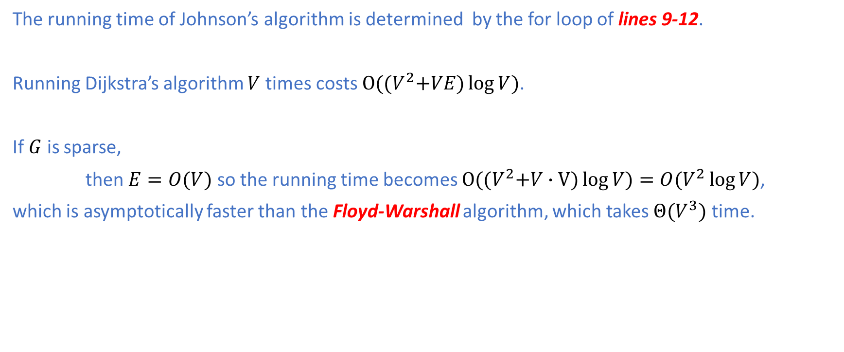
Johnson’s Algorithm: Analysis
The running time of Johnson’s algorithm is determined by the for loop of lines 9-12.
Running Dijkstra’s algorithm $V$ times costs $O({(V}^{2}+VE)\log{V})$.
If $G$ is sparse,
then $E=O(V)$ so the running time becomes $O({(V}^{2}+V∙V)\log{V})=O(V^{2}\log{V})$,
which is asymptotically faster than the Floyd-Warshall algorithm, which takes $Θ(V^{3})$ time.

Slide 35
Summary
In this lecture, we have covered the topic of all-pair shortest path problems:
All-Pair Shortest Path Problems
Naive Dynamic Programming View
Matrix Multiplication View
Floyd-Warshall Algorithm
Transitive Closure of Directed Graphs
Johnson’s Algorithm

